Slide 1



FOOD GROWING DEMAND
GLOBAL SOIL PARTNERSHIP SESSION
Berlín, GERMANY - Thu 31 October
How to promote sustainable soil management? Crucial elements that the plan should foresee
Ing. Agr. Maria Beatriz (PILU) Giraudo
Vice President Aapresid - ARGENTINA
giraudo@aapresid.org.ar
www.aapresid.org.ar

Slide 2





Aapresid’s Mission
ARGENTINIAN NO TILL FARMERS ASSOCIATION
To promote the No Till system in order
to achieve an economically, environmentally and socially sustainable agricultural activity based on technological, organizational and institutional innovation, undertaking the commitment to interact with public and private organizations to achieve an integral development of our Nation.

Slide 3
CONVENTIONAL TILLAGE PARADIGM
Virgin soil
Structure
Porosity
Fertility
SOM: 5-6%
ROUTE FOLLOWED UNTIL THE PRESENT
HUMAN FACTOR
TILLAGE =
DEGRADATION
UNSUSTAINABLE SYSTEM
ATMOSPHERE
CO2
PRODUCTION QUALITY WITH BIG AMOUNTS OF EXTERNAL INPUTS
CURRENT SOIL
Loss of fertility
Loss of porosity
Loss of structure
SOM: 2-3%
R. Fogante / 98
Notes:
The eroded soils are the result of lot of years of conventional tillage agriculture, another non sustainable practices, disasters, etc.

Slide 4
NO TILL SYSTEM
Virgin soil
Structure
Porosity
Fertility
SOM: 5-6%
ROUTE TO FOLLOW
NO TILL
HUMAN FACTOR
COVERED SOILS
ATMOSPHERE
CO2
BIODIVERSITY
CURRENT SOIL
Loss of fertility
Loss of porosity
Loss of structure
SOM: 2-3%
PROPORTIONALLY LESS EXTERNAL INPUTS
R. Fogante / 98
Notes:
So we must take the opposite way as soon as possible, to bring these soils to resemble as closely to the virgin soils through the adoption of no till+cover soils+biodiversity we can recover porosity, structure, organic materials, make less carbon emissions between others.

Slide 5
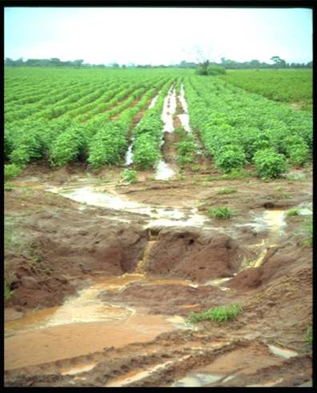
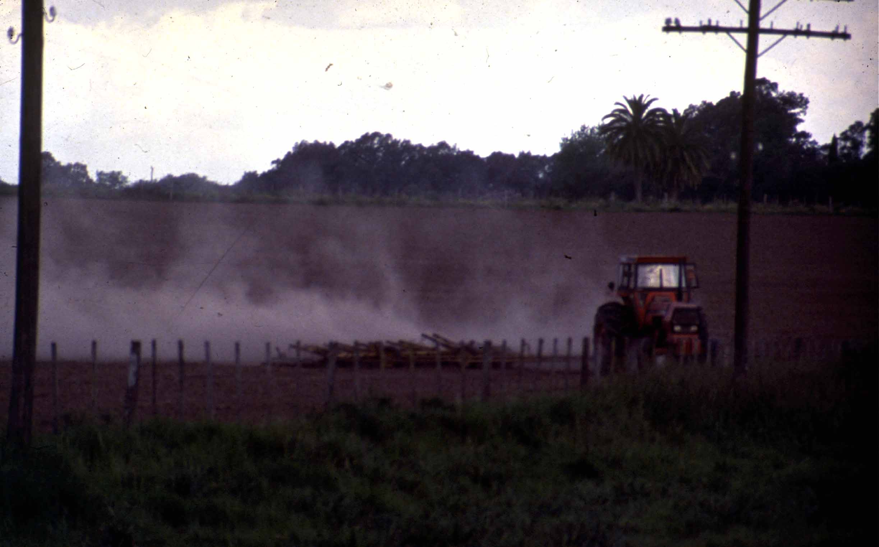
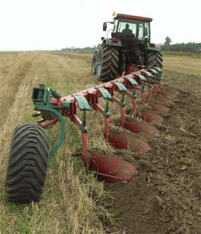
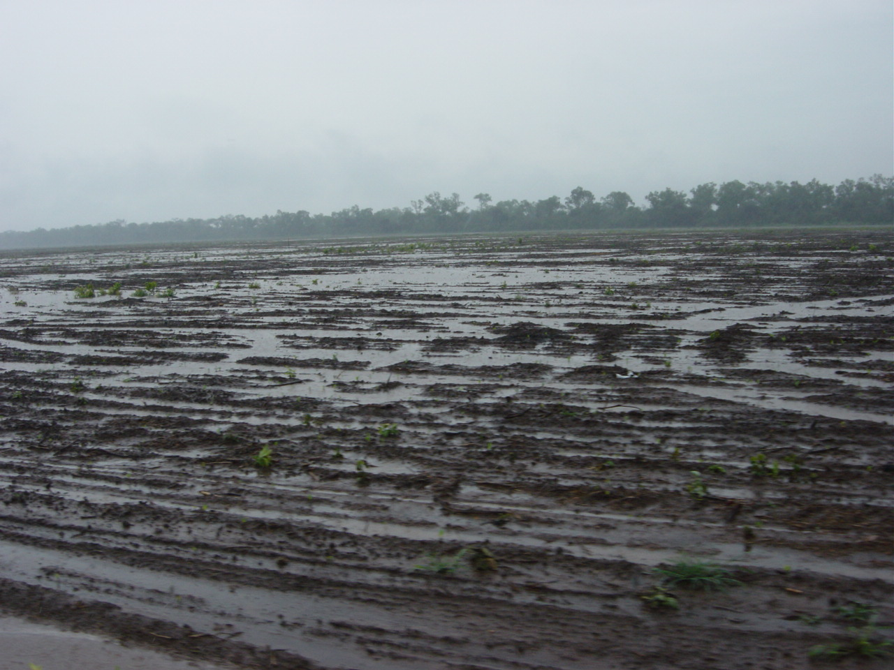
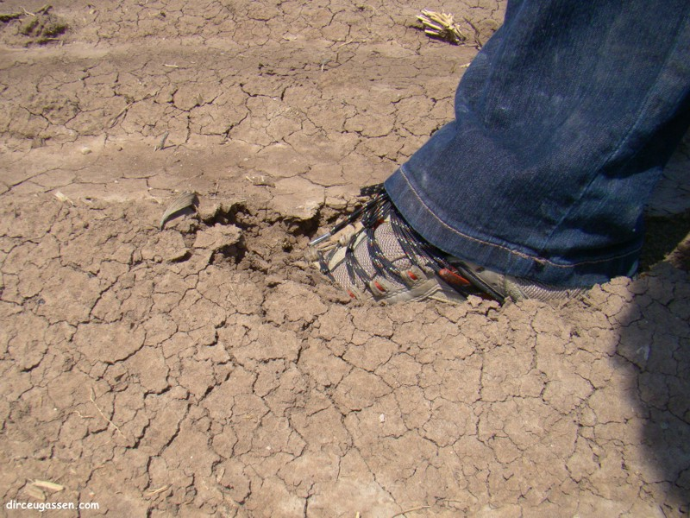
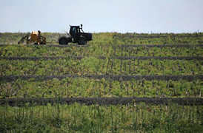
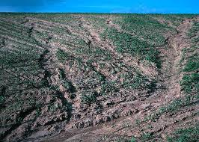
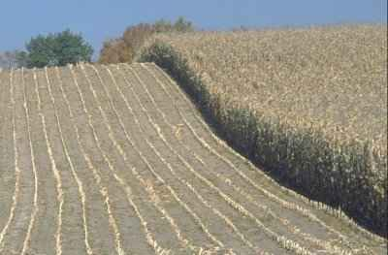
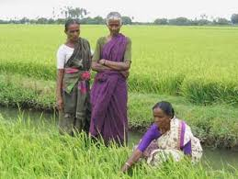
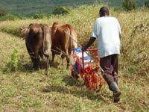
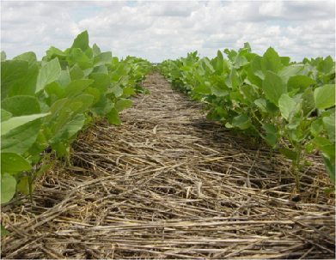
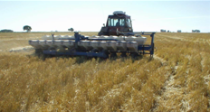
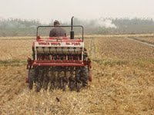
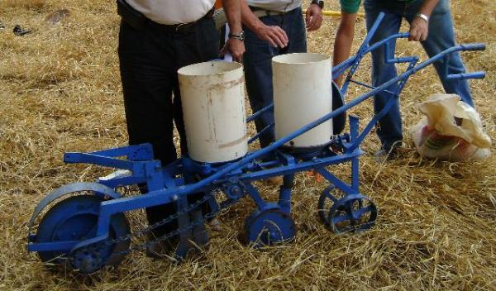
FOOD GROWING DEMAND
www.aapresid.org.ar
Notes:
This change of agricultural paradigm can be global, different regions with differents barriers, slopes soils, complement of terracing, big producers, smallholders/family farmers. We must adapt the technology package, transference and financial/incentive for each need and particularly situation.

Slide 6
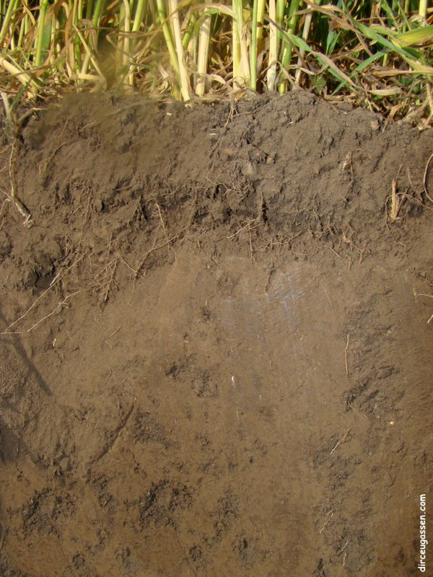
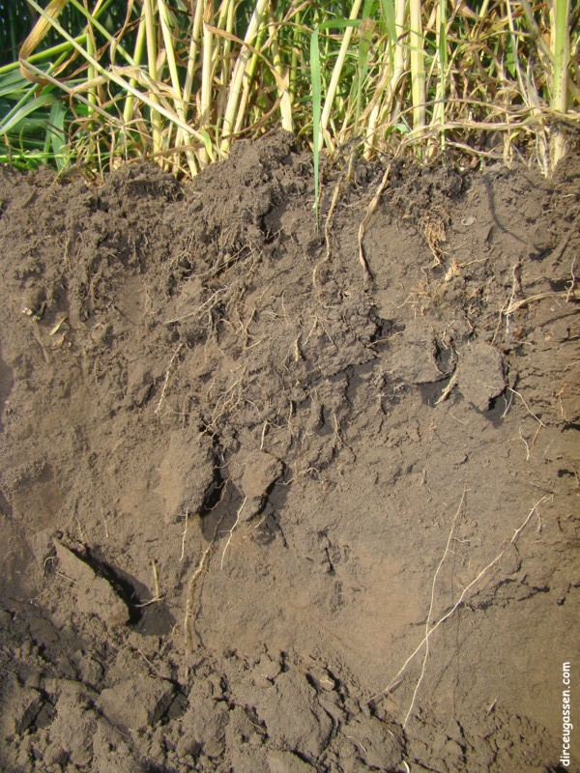
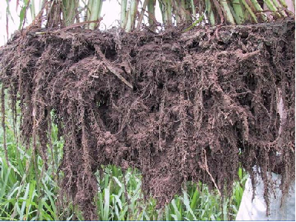
FOOD GROWING DEMAND
PLOW PAN
www.aapresid.org.ar
Notes:
Look at this pics, tillage destroyed the soil, sealed it, life there is limited. No till promote the regeneration of soils, porosity, new organic material , roots, alive soils...
The roots of different crops are the best implements to avoid compaction because they provide nature and stable solutions over time.

Slide 7
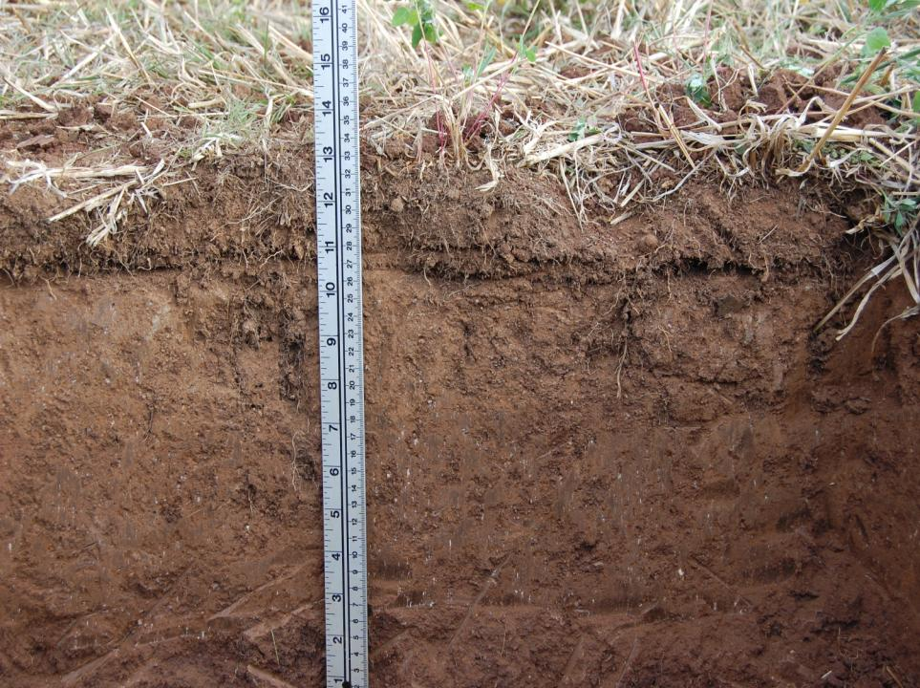
FOOD GROWING DEMAND
NO TILL
Soil erosion reduction by 90%
Water evaporation reduction by 70%
More soil biodiversity and biological activity
Use of fossil fuel reduction by more than 40%
www.aapresid.org.ar
Notes:
Why permanent no till is crucial ?

Slide 8
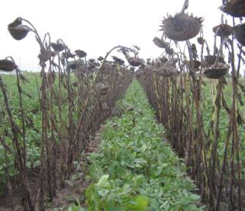
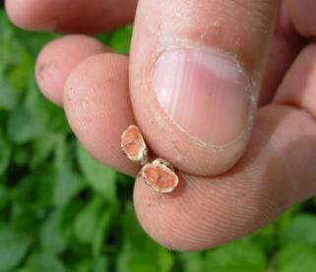
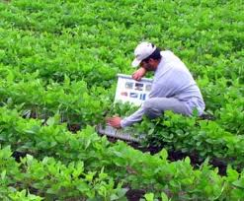
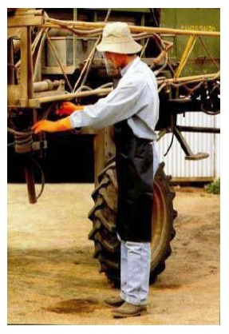
NO TILL + GOOD AGRICULTURAL PRACTICES
FOOD GROWING DEMAND
RESPONSIBLE AGROCHEMICAL MANAGEMENT
CROP ROTATIONS
BALANCED
NUTRITION
INTEGRATED PEST MANAGEMENT
Better physical, chemical and biological soil conditions
Increased soil biological activity and biodiversity
Improved soil fertility and nutrients cycling
Higher water use efficiency (less consumption and plus storage)
Carbon sequestration
Higher yields and increased yield stability
www.aapresid.org.ar
Notes:
But no till and soils surface covered by straw alone is not enough, we need of good agricultural practices.
Crop rotation adapted to every environment and regional economy , with a strategic and balanced nutrition, with an integrated management of weeds, insects and diseases, with responsible choice, use and application of phytosanitaries.
Sustained or improved benefits over time

Slide 9
SUSTAINABILITY, a simple equation
FOOD GROWING DEMAND
NoTill
E
V
O
L
U
T
I
O
N
NTS= No till + GAP + time= Sustainability
No + Yes + Yes= No
Yes + Yes + No= No
Yes + No + Yes= No
Yes + Yes + Yes= Yes
SUSTAINABILITY
Visual and Lab indicators
www.aapresid.org.ar
Notes:
No till system means no remotion and GAPs sustained over time to reach sustainability. If anyone is not present, sustainability won´t be reached.
Biosystem in evolution…

Slide 10
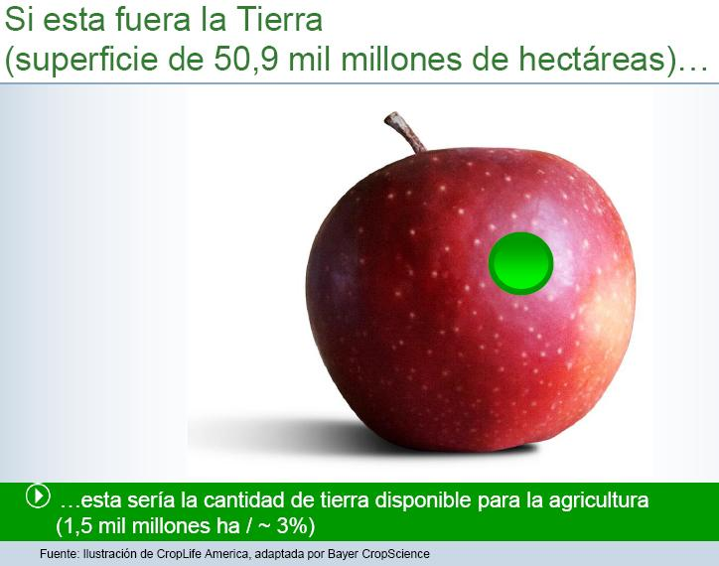
If this was the Earth
(total area 50,9 billions of hectares)
+ 75 % in AMERICA
(60 % South America)
<8% NT
Global agricultural area
(1,5 billions of hectares ~ 3%)
Notes:
Earth area and actual agricultural area (3%). Less than 8% of its agricultural area is under no till, more or less 125 million hectares. The 75 or 80 % of these area is provided by the American continent, mainly the Southern Cone.

Slide 11
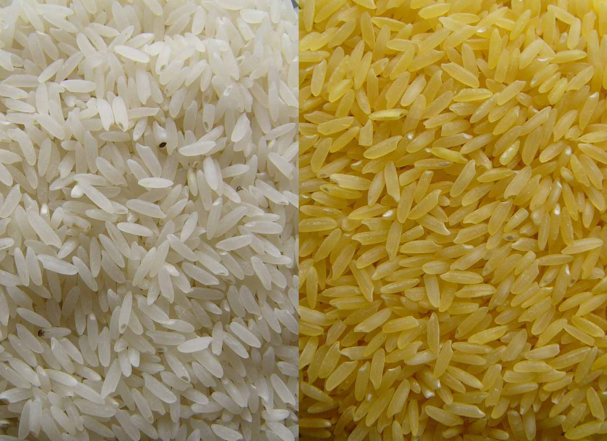
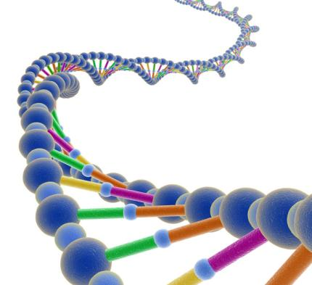
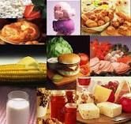
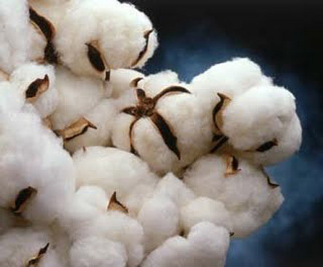
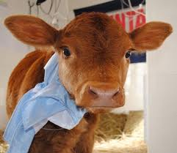
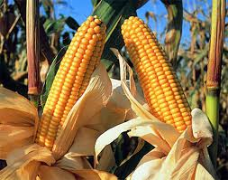
BIOTECHNOLOGY
FOOD GROWING DEMAND
www.aapresid.org.ar
Notes:
Biotechnology as a tool for provide the opportunity to improve quality and quantity production, production in marginals areas for example with salinization, will give the possibility to produce with less water, less use of chemical fertilizers and reduced use of phytosanitaries between others in the nearly future

Slide 12
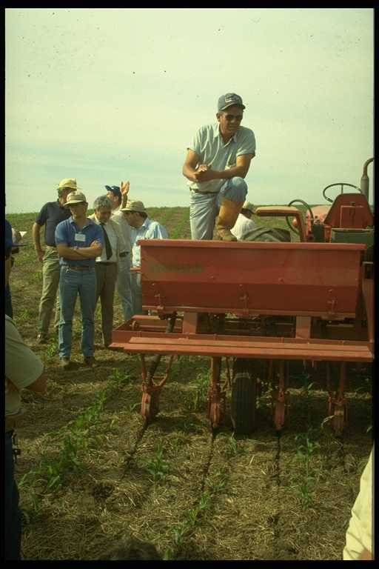
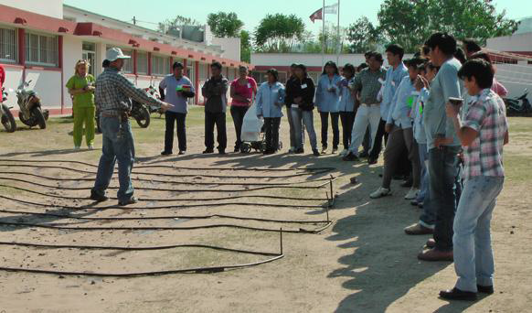
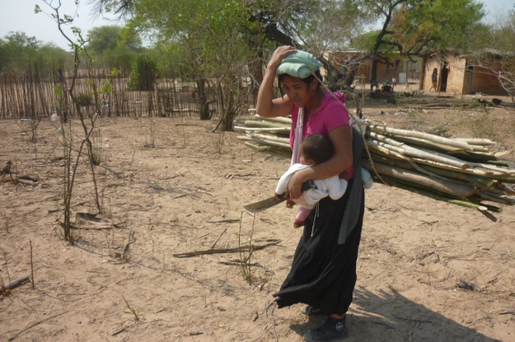
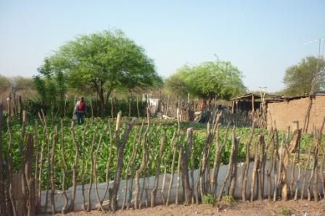
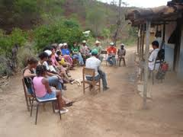
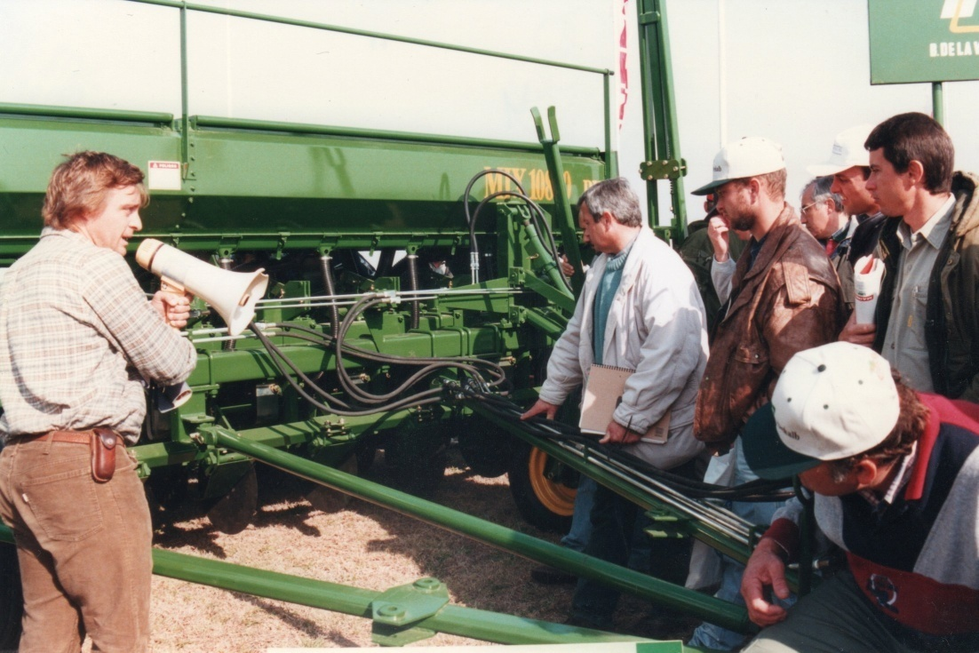
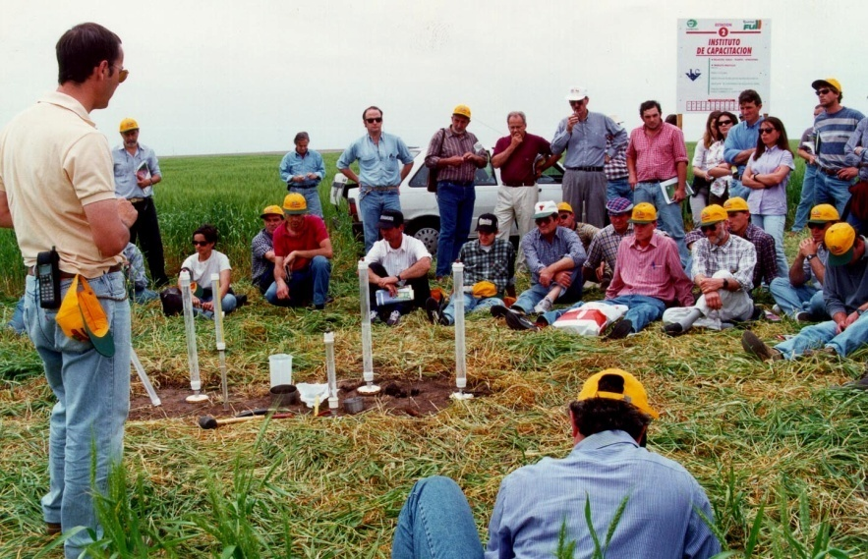
FOOD GROWING DEMAND
www.aapresid.org.ar
Notes:
PRODUCER, the most important/principal actor in this discussion. Farmers need to feel that the technology you want to transfer provides a real solution for their problems. This is for every scale (big, medium, smallholders) production, genre, region ... is an universal and basic condition for adoption. Therefore it is crucial to promote exchange between producers, detect leaders that will spread the sustainable management, then the exchange between producers and technicians, between technicians, and technicians and scientists.

Slide 13
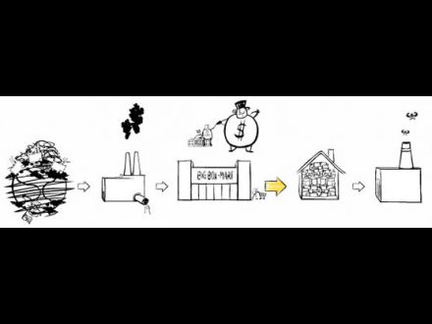
FOOD GROWING DEMAND
Extraction
Production
Distribution
Consumption
Disposal/Waste
Growing demand for environmental care
SUSTAINABILITY
Source: The Story of Stuff, Annie Leonard
www.aapresid.org.ar
Notes:
The demand of sustainability from society is growing and the step of production is the hardest hit. Here we also have a challenge to improve our communication to the all society. Showing sustainable management systems that promote soil, water, air and biodiversity security, therefore food security minimizing the consequences of climate change.

Slide 14
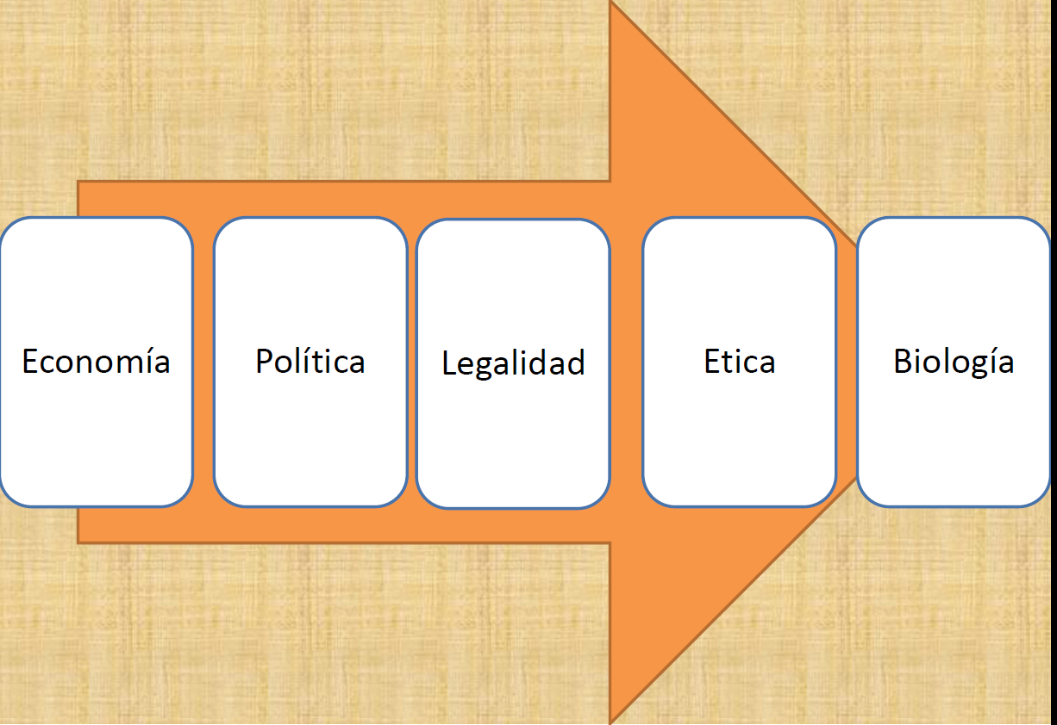
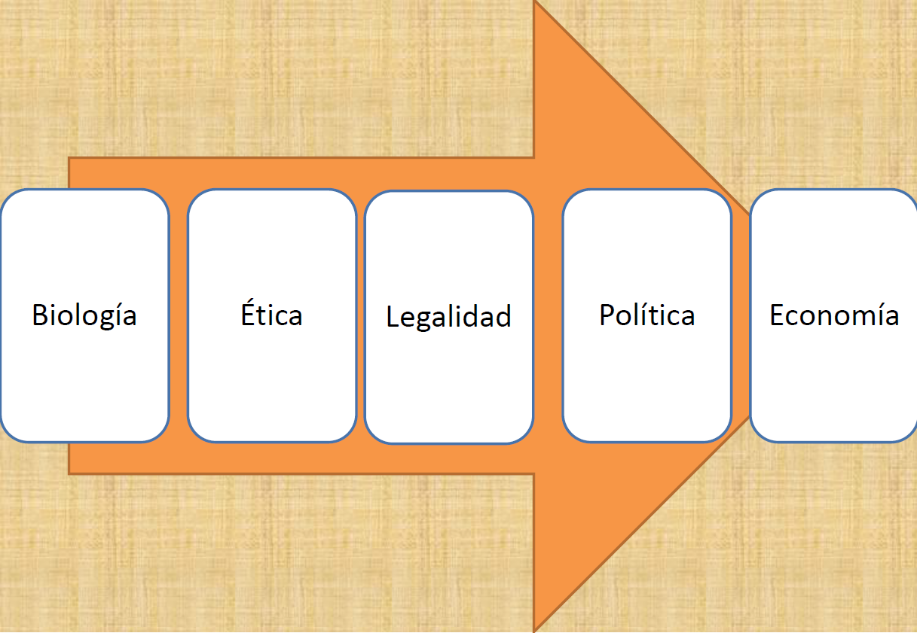
LOGIC CHANGE PROPOSAL
FOOD GROWING DEMAND
From the
Economy
(company)
Economy
Policy
Legality
Ethics
Biology
To the Economy
(company)
WIN – WIN - WIN
Biology
Ethics
Legality
Ethics
Policy
Economy
INSTITUTIONAL
FACTOR
www.aapresid.org.ar
Fuente: adaptación
C. March-AVINA
Notes:
The research community (with scientific arguments) and farmers organizations (with field experience) must work in proposals together to warn governments/policy makers and society of the need for policies to achieve these practices. And here we have a Logic change proposal: starting from the biology, ensuring quality life into an ethical project, with a legal framework, with appropriate policies and economy profits
Institutionalization is the set of institutions and rules that allow a society answer to the dilemmas and sustain solutions to social problems over time .

Slide 15
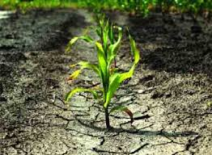
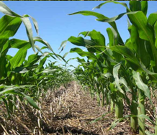
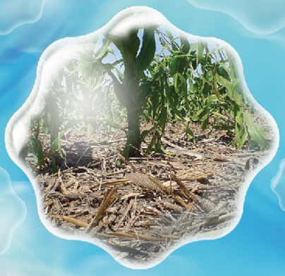


Let´s change together !!!!
FOOD GROWING DEMAND
SOIL + WATER + AIR SECURITY
BIODIVERSITY
CLIMATE CHANGE MITIGATION
RENEWABLE ENERGIES
FOOD
SECURITY
MANY THANKS!!!!
www.aapresid.org.ar
Notes:
If all society knows the possibility of the sustainable production systems, will require governments policies based on clear rules that promote these systems for guarantee soil, water, air and biodiversity security, therefore food security minimizing the consequences of climate change.

